Slide 1
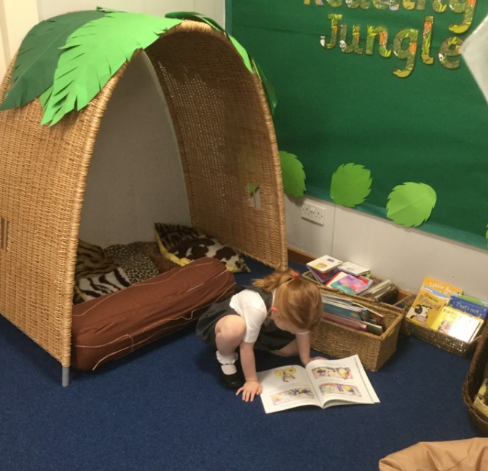

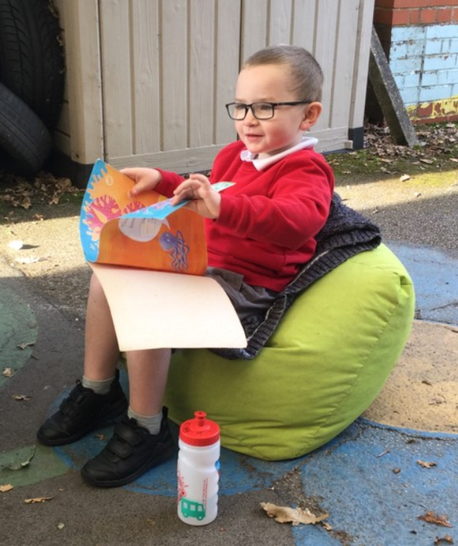
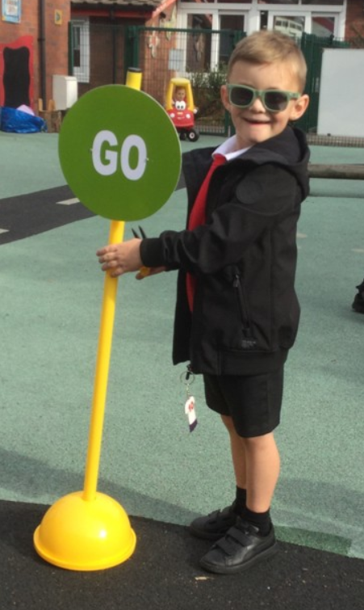
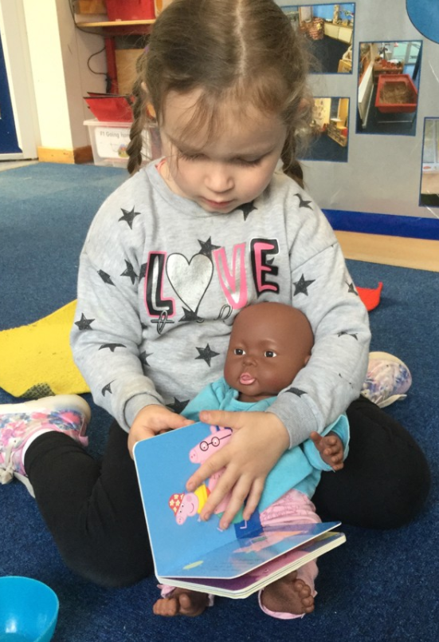
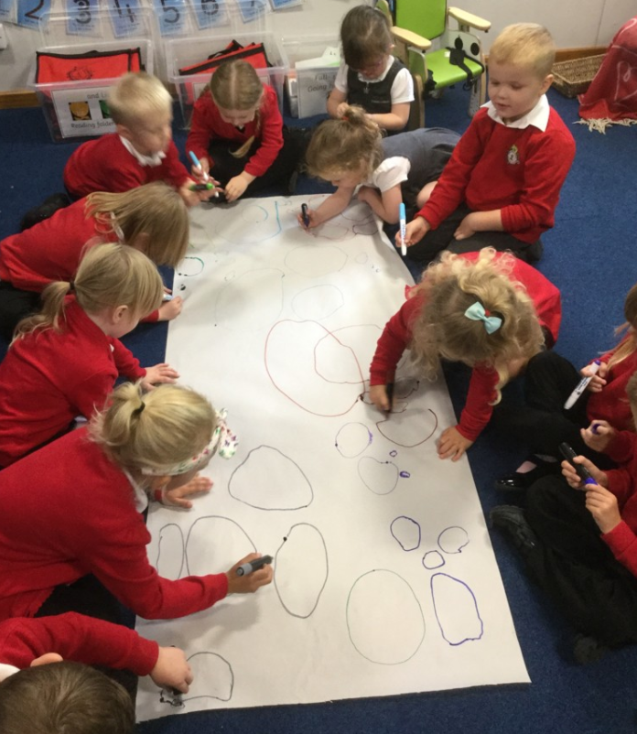
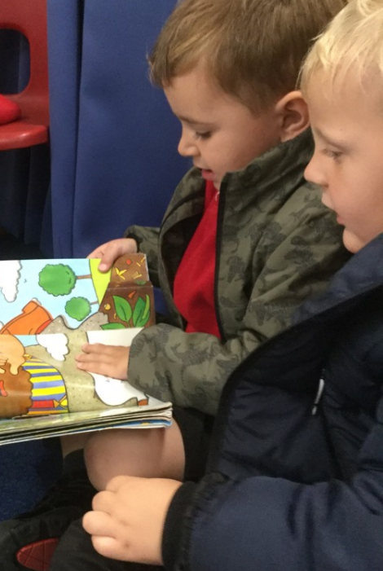
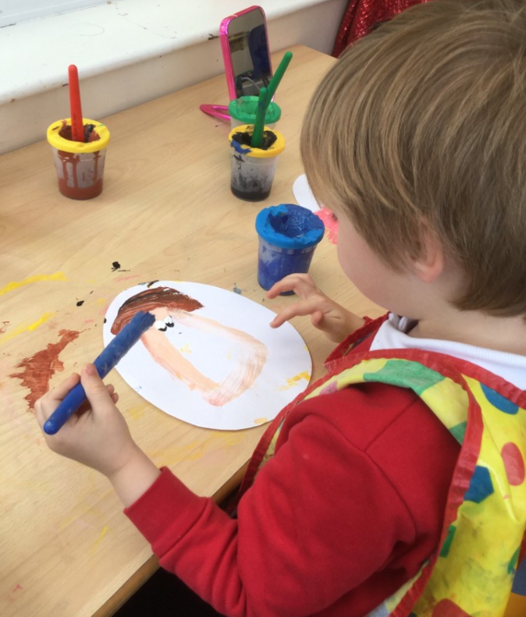
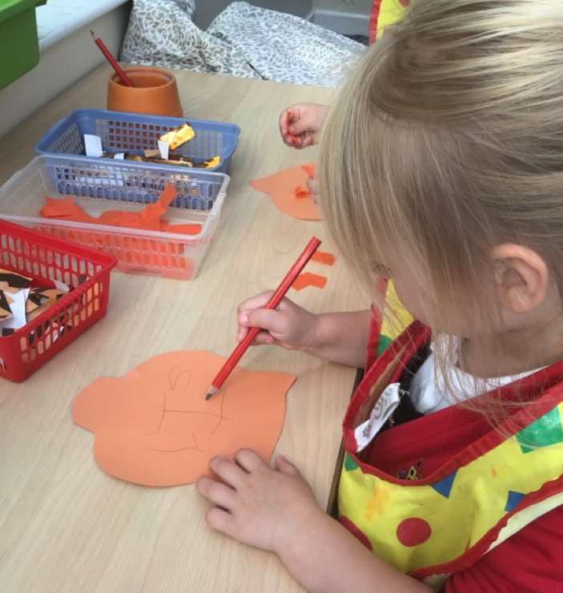
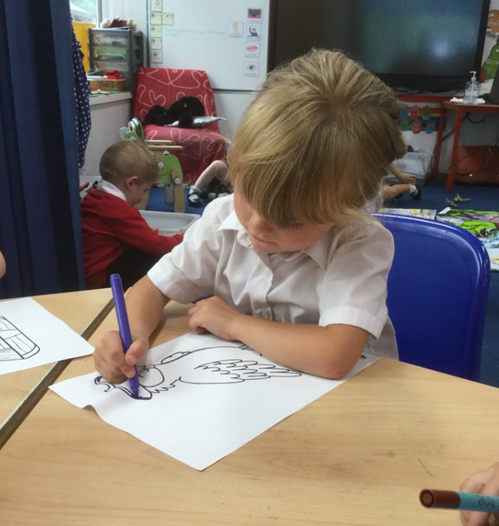
Early Reading and Writing.
F2
How to help your child at home.

Slide 2
The Early Years Curriculum
We have a play based curriculum in Foundation, through this we teach the children how to be independent learners. This includes managing their learning, their belongings, their hygiene and their feelings when building relationships with others. We are constantly talking about problem solving.
The children have constant access to provision indoors and outdoors and it is important they have chance to lead their learning.
Adults in Foundation observe, enhance and extend their learning in free flow when appropriate.
It is important to us that we help our children grow as people. They learn to be kind, polite, confident and hopefully, to love learning! We take lots of time to nurture them as a whole child and make sure they feel safe and secure. However, as well as this we also need to focus on academic skills that will help them in their journey through school.
In F2 we also have teacher led learning times and guided learning times. This is more frequent than in F1 and the children will sometimes be expected to record their learning.
In F2 we are working towards the end of year goals called ‘Early Learning Goals’ of which there are 17!

Slide 3
Early Literacy: Emerging Reading and Writing
Writing Early Learning Goal
Write recognisable letters, most od which are correctly formed
Spell words by identifying the sounds in them and representing sounds with a letter or letters
Write simple phrases and sentences that can be read by others.
What does expected look like?
Reading Early Learning Goal
Say a sound for each letter of the alphabet and at least 10 digraphs
Read words consistent with their phonics knowledge by sound-blending
Read aloud simple sentences and books that are consistent with their phonics knowledge, including some common exception words
Demonstrate understanding of what has been read to them by retelling stories and narratives using their own words
Anticipate key events in stories
Use and understand recently introduced vocabulary during discussions about stories, non-fiction, rhymes and poems and during role-play
What does expected look like?

Slide 4
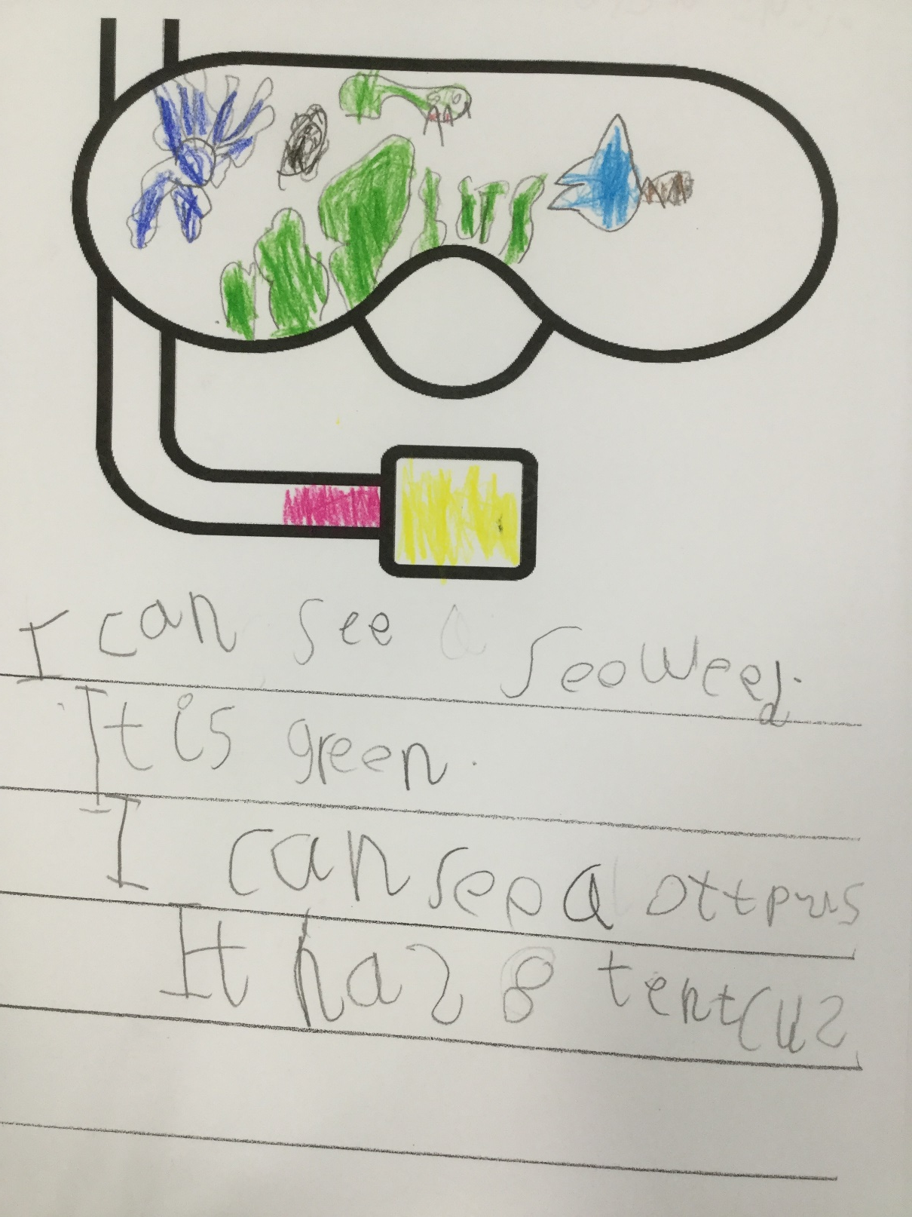

Slide 5
How do we teach children to read and write?
We teach our youngest children to read and write by teaching them the phonetic code.
What is Phonics?
Phonics is an awareness of different sounds in spoken language. Children develop an understanding that spoken words are made up of different sounds and they learn to match these sounds to letters in order to read and write.
At Church Vale we teach phonics using our own systematic, synthetic phonics program.
Children are taught phonics in F1, F2 and Y1. They receive a stand alone phonics lesson everyday.
Our program has a carefully planned timeline which the children progress through during the Foundation stage and Key Stage one. This allows them to build on prior knowledge and quickly learn the alphabetic code. They are taught as a whole class and provided with additional support if needed.
Pupils in Year One take a national phonics test to assess their phonetic knowledge.
‘Time to Read’ sheets are sent home after each phonics lesson to practise the phoneme they have learnt at home. Please spend 5 minutes with your child looking at this sheet.
The aim at Church Vale is for our children to become fluent in reading and writing.

Slide 6
What are they talking about?
During phonics lessons children are taught technical vocabulary. They may come home and use this vocabulary, so here is a helping hand:
Phoneme- The smallest unit of sound. Phonemes can be put together to make words.
Grapheme – A written phoneme. Graphemes can be made up from one letter such as g, two letters such as ch or three letters such as igh.
Digraph – Two letters working together to make one sound such as ch
Trigraph – Three letters working together to make one sound such as ure
Split Digraph – Two letters that are not side by side working together to make one sound (for example a_e in cake.)
Blend – putting the individual sounds together to pronounce a word as they read.
Segment – hearing a word and identifying the individual sounds that make it up in the correct order. This can then be used to spell a word.
Sneaky sounds – when two or three letters create shorter sounds that children often miss. These are known as blends. For example, ‘st’ in ‘stop’ or ‘str’ in string.

Slide 7


Reading
Children are taught to say the phonemes and blend them together to make a word
e.g. c-a-t = cat.
We encourage our children to use ‘blending arms’ to
pretend to push the phonemes together.
As children gain more confidence, they will not need to ‘segment’ and ‘blend’ words to read and we encourage children to say the word as a whole when they are ready.
A way to support children recognising graphemes in words is to encourage them to put ‘sound buttons’ underneath. If they spot a digraph or trigraph, they put a long sound button underneath.
We also teach children sets of ‘fast words’. These are either words that are not decodable or words that are seen regularly in books. Having a bank of sight words will help children to become fluent. Please look out for your child’s fast words in their reading diary, regularly practising reading and writing these words makes a huge difference.

Slide 8
Helping your child to read at home.
All children take home a reading book (a book matched to their reading and phonics ability) and a sharing book (a book for you to share together) every week.
In F2 and Y1 children will bring home a ‘phonetically decodable book’ that matches their phonics ability. Once they have passed their phonics screening check in Y1 (this may be before the official screening) they will move onto real reading books which follow a sequence of colour bands and have a small coloured sticker. Real reading books support children in learning strategies such as: pointing to words, making predictions, talking about the plot and characters, reading ‘fast words’, gaining fluency.
Phonics books support children to apply their phonics knowledge such as: spotting graphemes, blending and segmenting.
We change books once a week in school but the day may change so we ask reading folders to be in school everyday. To provide more books for home, each child has a login to Big Cats e-library. This provides you with a range of phonetically decodable books to practise applying their phonics skills.
We encourage all children to read at least 3 times a week but preferably most days.
Remember to read to your child too, story time is invaluable to instil a love of reading.
Remember to practise reading and writing ‘fast words’ too. Fast words will be sent home each time children learn a new set.

Slide 9
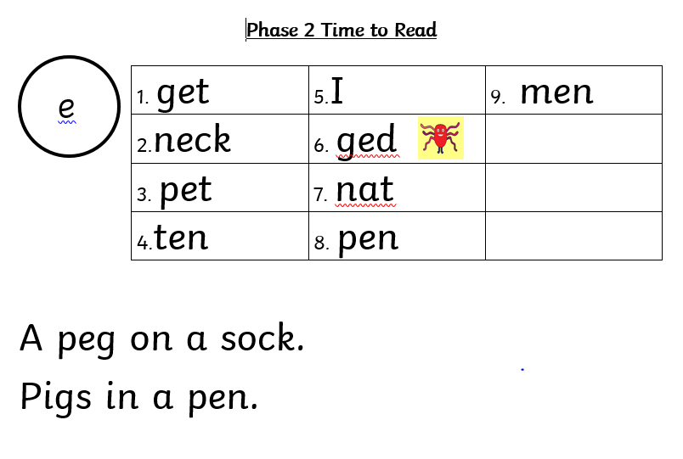
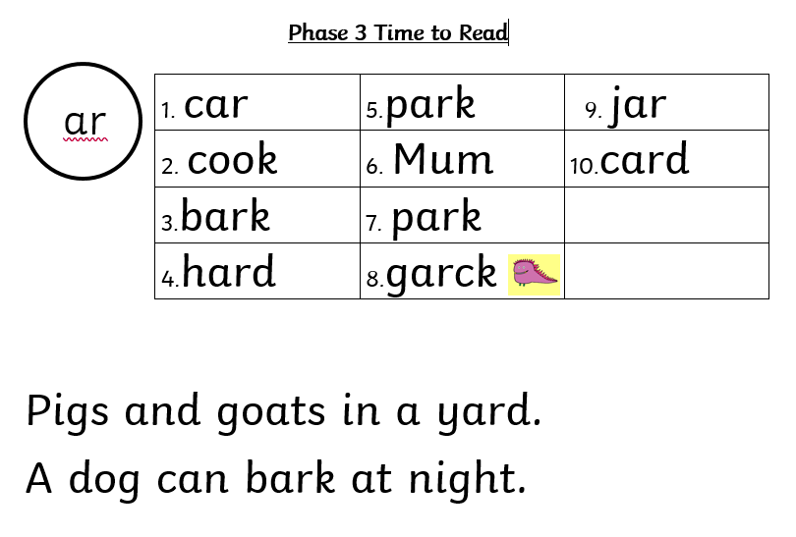
Time to Read sheets
Today’s grapheme
Alien Names
Sentence reading

Slide 10
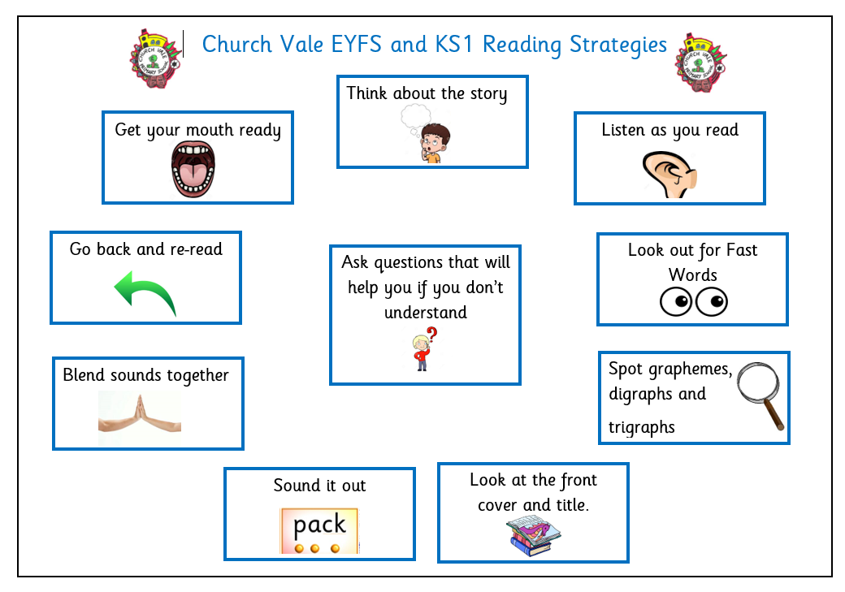
Other Reading Strategies

Slide 11
When listening to your child read, remember:
Encourage them to turn the pages and point to the words if they need to.
Have a go by themselves before you offer help.
Remind your child to spot graphemes and fast words.
Remind your child to segment and blend unfamiliar words as their first approach.
Read words from sight as soon as they are able to.
Once they have blended words, go back and re-read the sentence so they can make sense of it.
Talk to your child about what they have read to check their understanding.
Praise them for trying hard.

Slide 12
Writing
When learning to write, children are encouraged to listen to the phonemes in words and ‘segment’
We use ‘robot arms’ to mimic chopping up the phonemes as they segment a word. Often children begin by hearing the first phoneme, but with practise, they start to hear the middle and final phonemes in words.
Don’t worry if at first your child spells things incorrectly, this is part of the process. Once they begin to progress through phonics lessons, we start to correct spellings and apply what they have learnt in sessions.
We always encourage children to spell ‘fast words’ correctly.

Slide 13
Helping your child to write at home.
Encourage your child to write their own name (first and last) on cards for family, pictures, signs for bedroom doors.
Practise using tools, cutlery and pencils for writing. This relies on fine motor control so any activity that involves children pinching their fingers will help to build up strength. E.g. playdough, pegs, threading, jigsaws, tweezers.
When your child has drawn a picture, encourage them to label it.
To begin with, this may just be the initial sound. Then a label (remember this wont be spelt correctly) and further into their development, they can write a sentence to match their picture. Remember to encourage them to plan aloud before attempting to write.
Encourage your child to spell fast words correctly using the sets we send home
Encourage your child to write for purposes e.g. cards, place names at Christmas, signs for bedrooms, lists for shopping, labels for bedrooms

Slide 14
How to help your child in F1
Our phonics sessions in F1 are based on speaking and listening skills. You can help your child by encouraging them to:
Listen to sounds around them.
Sing action songs and nursery rhymes.
Make up sentences with words beginning with the same letter e.g. Sam saw a slippery snake.
Experiment with their voices to see what sounds they can make.
Sound talk to them to see if they can blend sounds together to make a word e.g “Put on your h-a-t, c-oa-t,” etc.
Segment words apart (talk like a robot) “Can you ask if Daddy wants cheese?” ch-ee-se.

Slide 15
How to help your child in F2
During F2 in Foundation Stage, children begin to learn single letter sounds (phonemes) to read and write words and sentences. They also learn fast words to read and spell correctly. We begin to read fake words and real words.
You can help you child by
Encouraging them to say the sounds correctly. Try not to add uh on the end e.g. m not mu
Watch this clip: https://www.youtube.com/watch?v=TTe5_Em0BHQ&t=26s to see how to pronounce phonemes correctly
Encourage them to orally segment words and blend them together using segmenting and blending arms.
Ask them to make words with magnetic letters. (pat sat etc) or write them down
Make words for them to read. (cup, pin, etc) and play a game of pairs
Practise reading ‘fast words’ from sight. Try to beat a timer, how many times can you read them before the timer runs out?
Encourage them to segment and write lists, posters, labels and simple sentences.
Listen to them read their reading book as often as you can.
Practise ‘Time to Read’ sheets.

Slide 16
How to help your child in F2
Once the children have learnt all single letter sounds, they begin to learn digraphs (two letters working together to make one sound) and some trigraphs (three letters working together to make one sound) such as igh in light and air in hair. They learn to use these phonemes to read and write words and sentences. Children also continue to learn fast words. We practise reading fake words and real words.
You can help by
Encouraging them to look for digraphs and trigraphs in words, using sound buttons if they need to.
Writing words using the phonemes they know. You could try writing in shaving foam, corn flour or using water and a paintbrush outside.
Encourage them to write sentences to match pictures they draw.
Helping them to practice reading and spelling the fast words.
Listen to them read their reading book as often as you can.
Practise ‘Time to Read’ sheets.

Slide 17
How to help your child in F2
Once children have learnt to apply trigraphs and digraphs to reading and writing, they learn to read and spell longer words including words containing adjacent consonants such as scarf and stop. This gives children the opportunity to practise using sounds they have learned previously in longer words and listen for ‘sneaky sounds’. We practise reading fake words and real words
You can help by
Encouraging your child to listen carefully for all the sounds in longer words before writing them.
Encouraging your child to segment and blend unfamiliar words as they read.
Help them to practice reading and spelling the fast words correctly including when they are writing for a purpose.
Encourage your child to add sound buttons to unfamiliar words. Remember they need to use long sound buttons for digraphs and trigraphs.
Listen to them read their reading book as often as you can.
Practise ‘Time to Read’ sheets.

Slide 18
Thankyou
If you have any questions about supporting reading and writing at home, please pop in to see your child’s class teacher.

